Slide 1
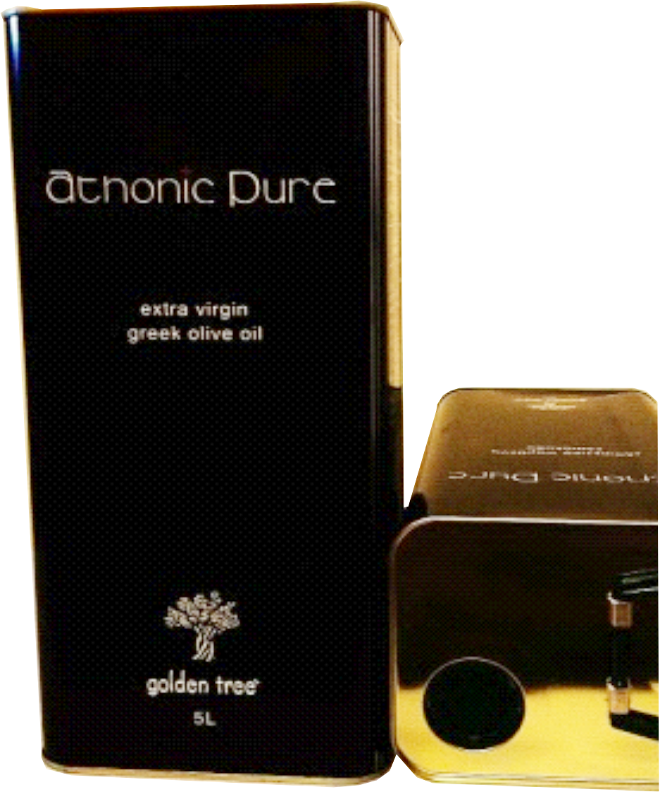
CATALOG

Slide 2
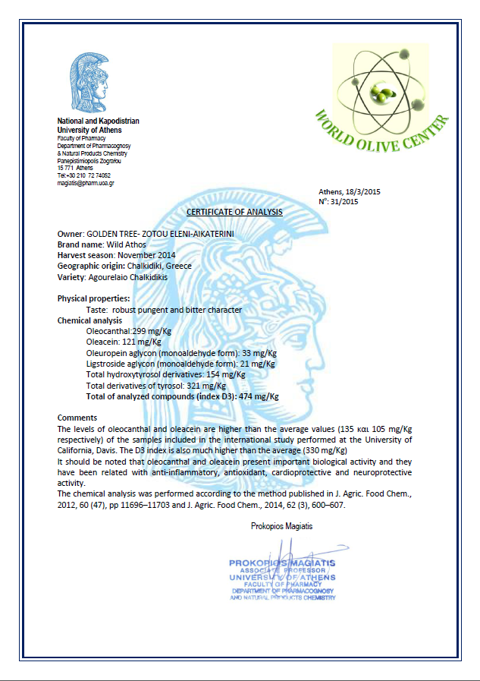
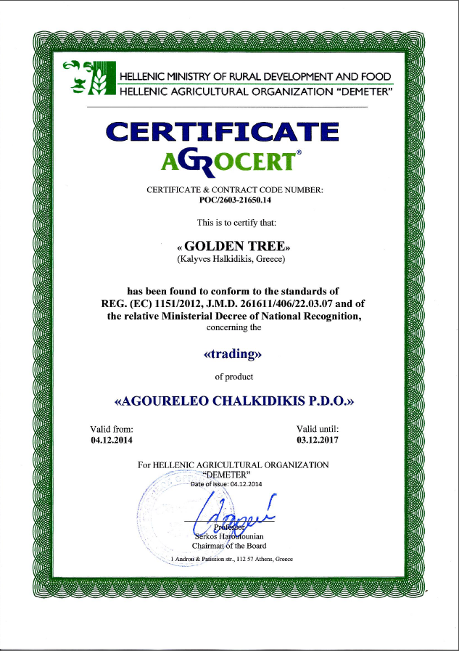
Wild Athos “Agourelaio” certificates
Wild Athos
“Agourelaio”
From unripe olives, collected by hand at mid-October and processed in 24hours.
Acidity: < 0.2%

Slide 3
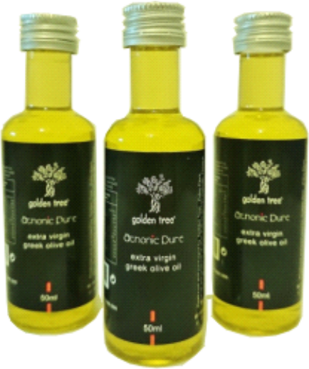
Extra virgin olive oil
“Athonic Pure”
Athonic pure
Extra virgin olive oil from olives collected by hand and processed with the method of cold pressing
Acidity: < 0.6%
Packages: 500ml, 750ml, 1000ml

Slide 4
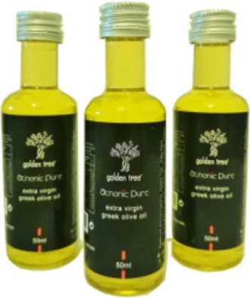
Extra virgin olive oil
“Athonic Pure”
Athonic pure
Extra virgin olive oil from olives collected by hand and processed with the method of cold pressing
Acidity: < 0.6%
5L package

Slide 5
Extra virgin olive oil with flavours
Athonic pure
Extra virgin olive oil from olives collected by hand and processed with the method of cold pressing mixed with several flavours
Banana
Rosemary
Orange
Lemon
Herbs
Laurel
Oregano
Thyme
Packages
Metallic 500ml, Glass 500ml

Slide 6
Salad oil
“Mystik”
Salad oil comes from mixing of extra virgin olive, as main ingrentient, with sunflower and olive-pomace oil
Packages
Metallic 1000ml & 5000ml
Glass 1000ml, Pet 3000ml

Slide 7
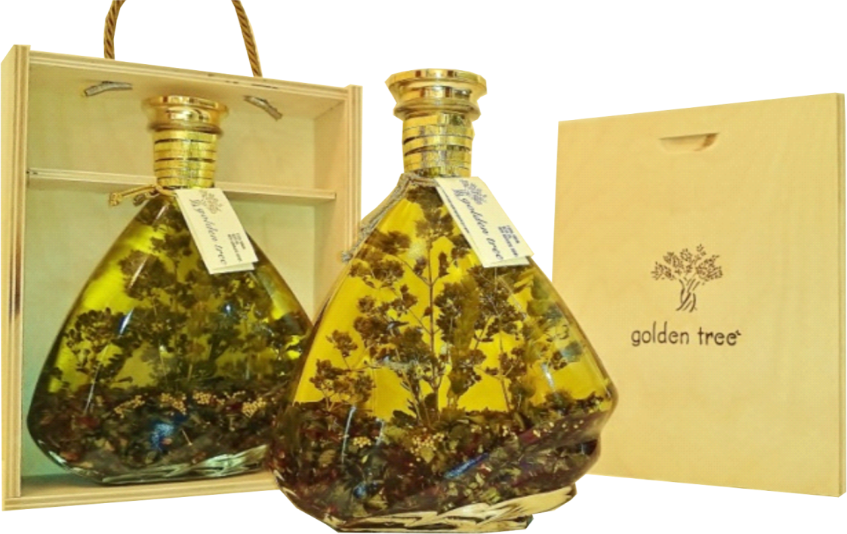
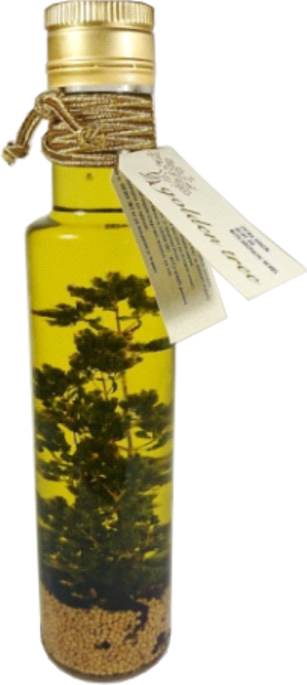
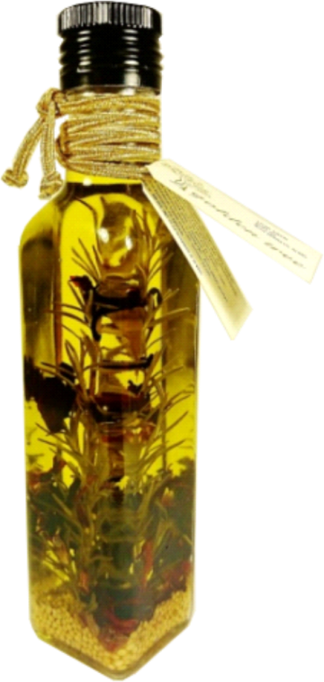
Excellent olive oils
Nature’s gifts for all…

Slide 8
tel.: +30 2310 650333
e-mail: info@goldentree.eu

